Slide 1
R&D Project Management Methodology
Week 3

Slide 2
Topics for Today
What is a PM Methodology and why do you need one?
How do you choose/create and justify one

Slide 3
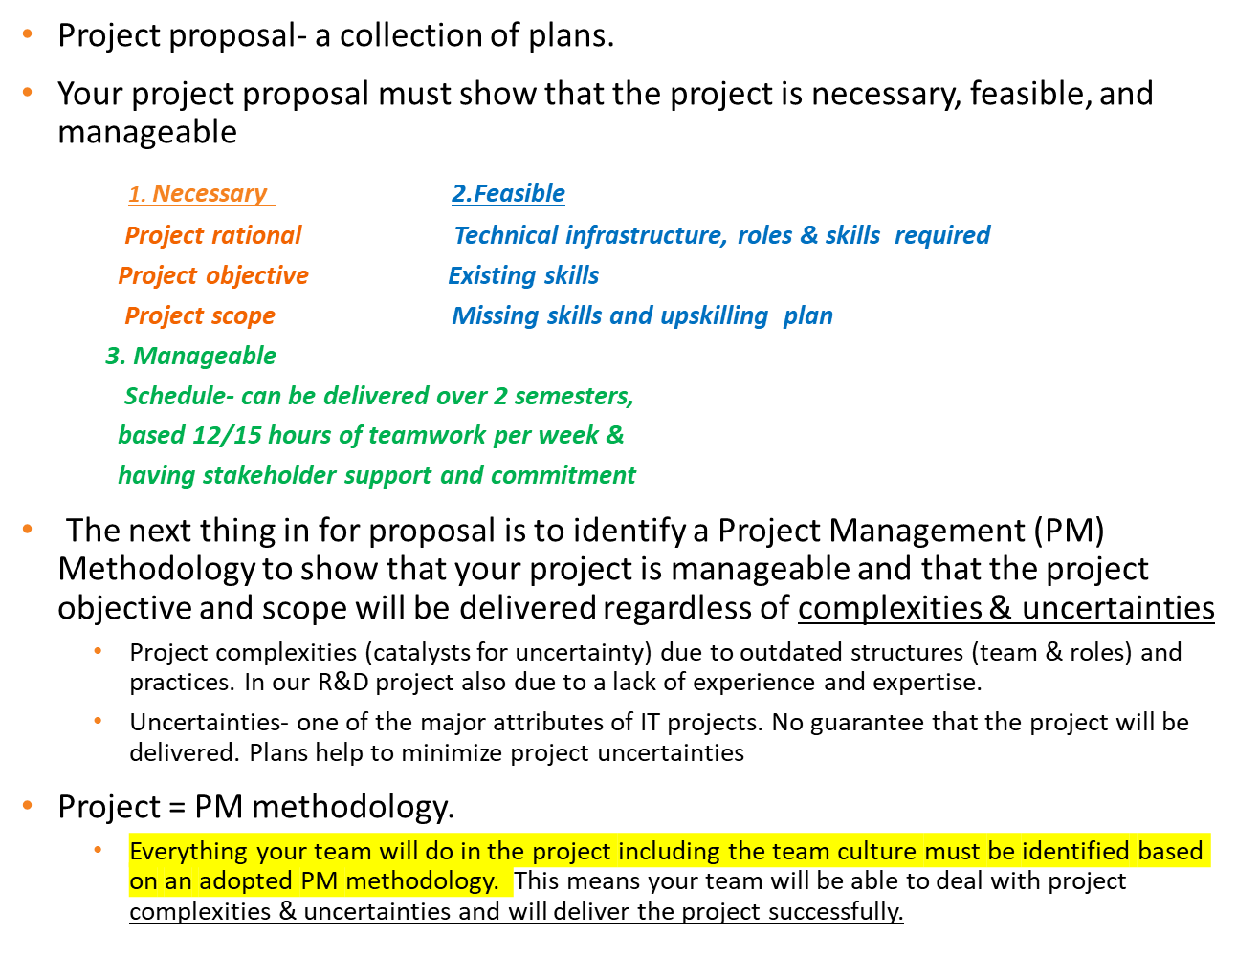
Important information (from last week)

Slide 4

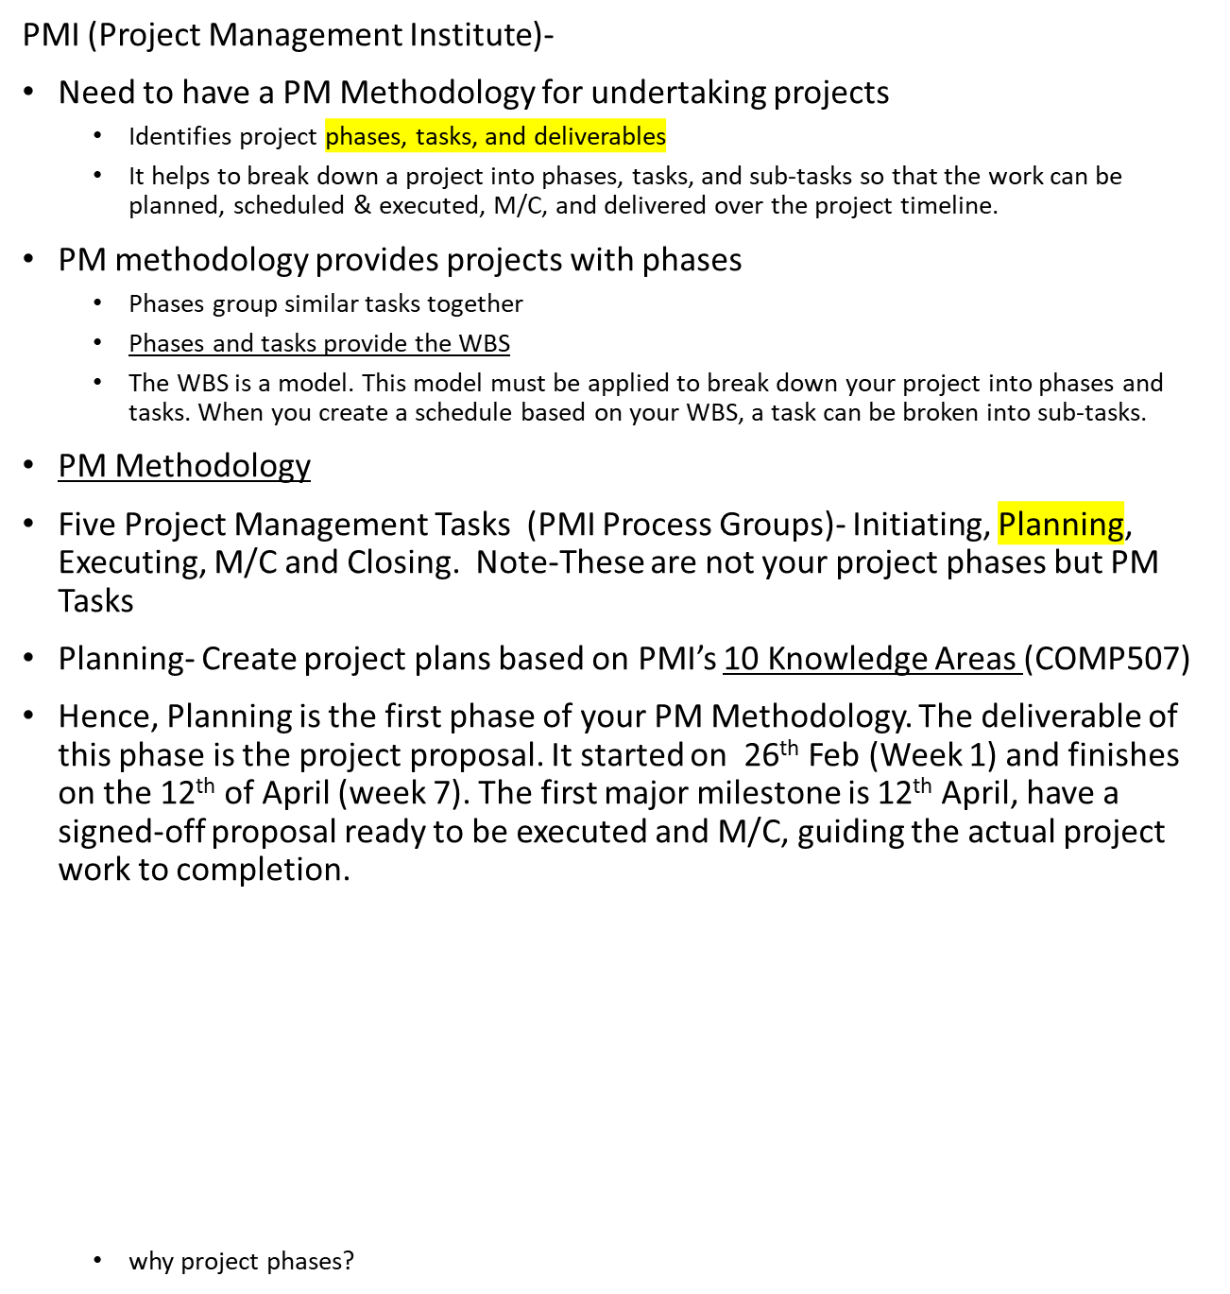
PM Methodology for R & D project

Slide 5
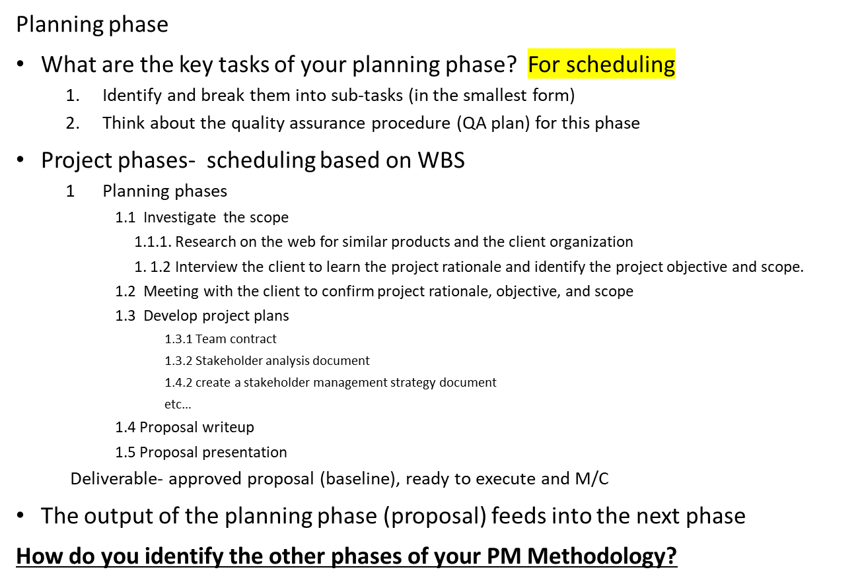
PM Methodology for R & D project

Slide 6
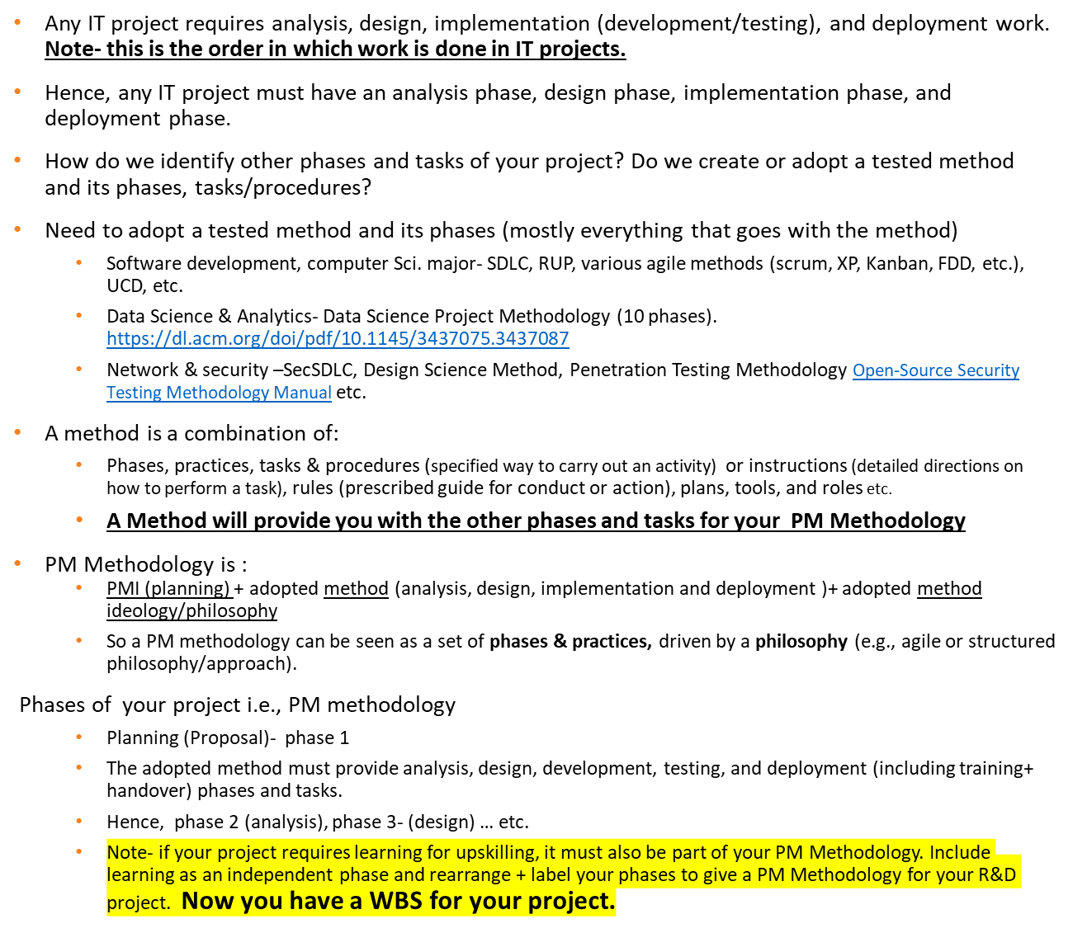
PM Methodology (WBS) for R & D project- the other phases

Slide 7
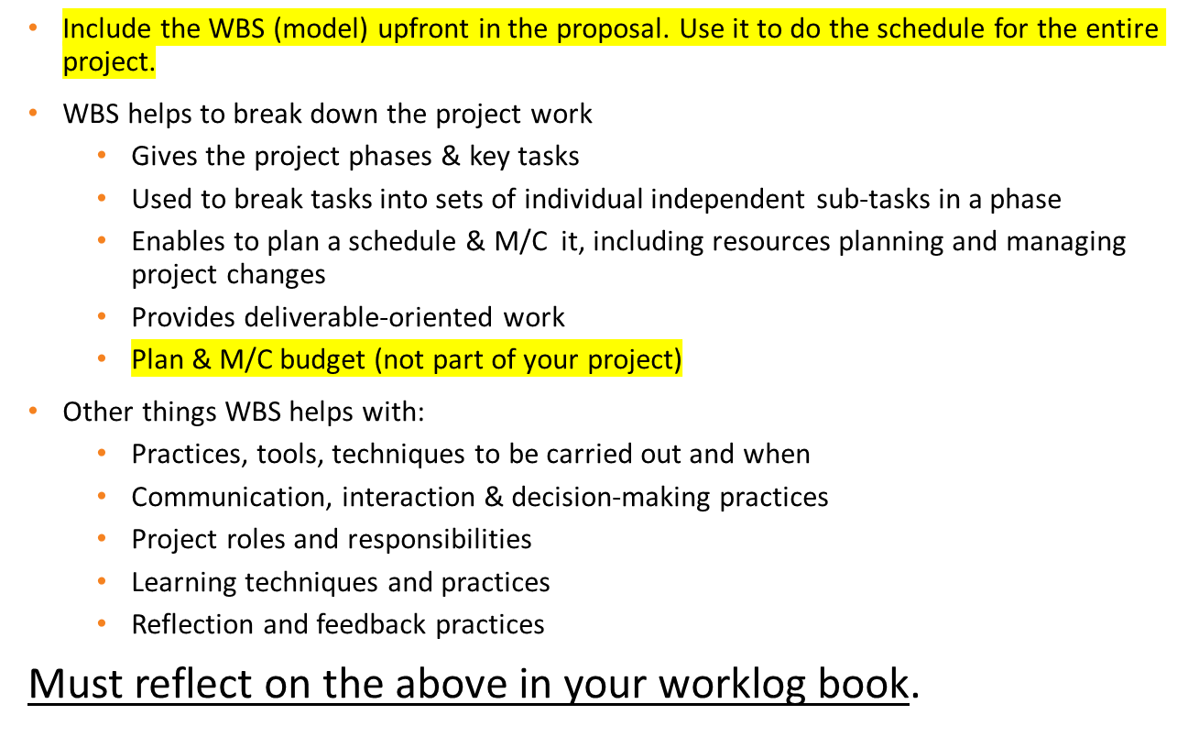
PM methodology (WBS) for R & D project

Slide 8
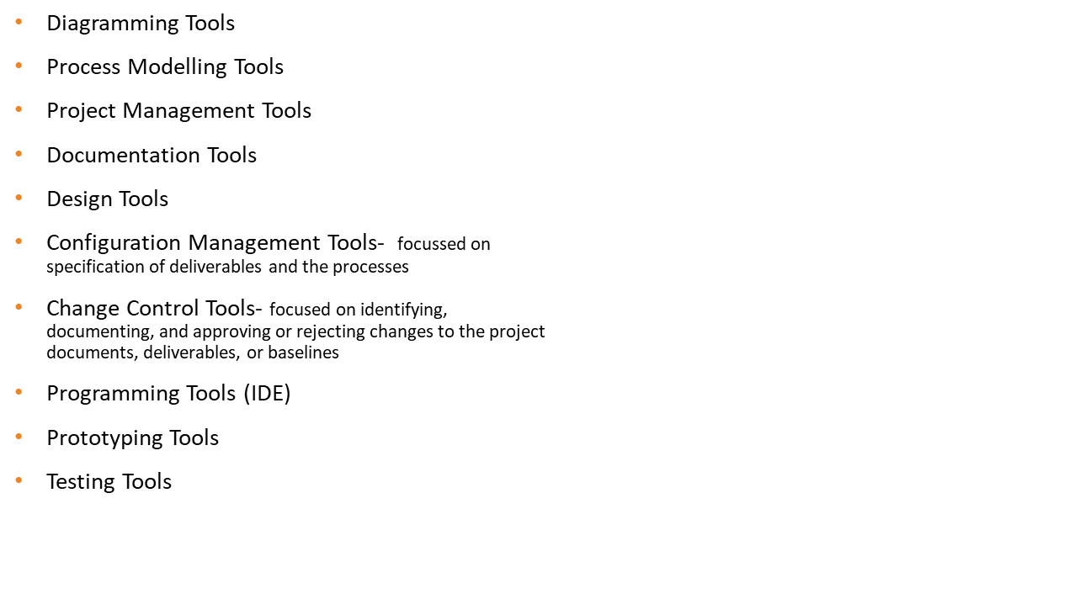
Are you thinking about tools for R&D….

Slide 9
Method choice for the project
Does the client have a method to offer the team?
  Good idea to investigate with the client
  They could provide you with templates and documents
  Coaching and training for the team
Which method have you learnt in class?
  XP
  Scrum
  RUP
  Feature Driven Design (FDD)
  COBIT or ITIL frameworks
  Waterfall
  The Scientific Method
  Web or mobile based systems? Maybe look to incorporating User Centred Design (UCD)
  Data Science Project Methodology (10 phases).
  SecSDLC, Design Science Method, Penetration Testing Methodology,
    Open- Source Security Testing Methodology Manual

Slide 10
Method choice for the project
The PM methodology will shape your team’s contract and teamwork
  Team contract must be revised to incorporate how the team will work based on the practices of the chosen method(s) including the expected behaviour

Slide 11
PM Methodology- team work practices to consider
  Team effort for decision-making, planning, and delivery commitment
  Task sharing - two or more people working together on a task (better quality and reduces the time taken for tasks)
  Plan driven - detailed (fine grain) plan for next week’s work
  Team workspace - do most work from the shared team workspace (offsite hours & R & D room plus other spaces available on campus)
  Work allocation - empowerment to choose and re-estimate effort
  Quality focus from beginning to end (quality plan)
  Short cycles – 2 or 3 weeks
  Consistent work pace in the project
  Testing (feedback, unit test, functional test, acceptance test, regression test)- upfront not only with implementation but with all phases
  Plan time to fix bugs and errors
  Have regular team and mentor meetings– on a weekly basis, set agenda
  Ensure client (& end user if possible ) input/feedback throughout the project
Capture your experience on these in the worklog book- will be part of your reflective report

Slide 12
Week 3 Critical Tasks
Client & mentor meetings
Continue fact finding for the project
List and prepare the plans which will be part of the proposal
Start getting feedback on some of plans if first draft is done
Start research on your PM methodology

Slide 13
A Tip- Start planning an executive summary for your proposal
An executive summary should never be longer than 10% of the document. 1 page at best.
An executive summary gives the reader a summary of the important facts for making a decision
Paragraphs should be short and concise.
Use bullet points, try to be jargon-free
Define the problem in clear, understandable terms
Summarise your preferred solution; articulate uniqueness
Summarise scope, timelines with major milestones, risks and budgets.
Sometimes - include a recommendation or call to action

Slide 14

Any Burning Questions?

